Slide 1
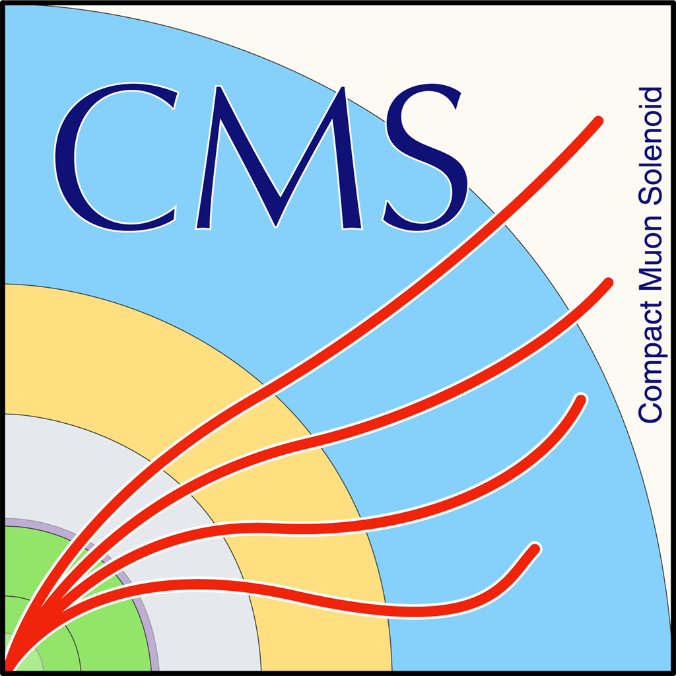

QCD Closure Tests 2016, 2017, 2018
George Bakas
Ioannis Papakrivopoulos

Slide 2
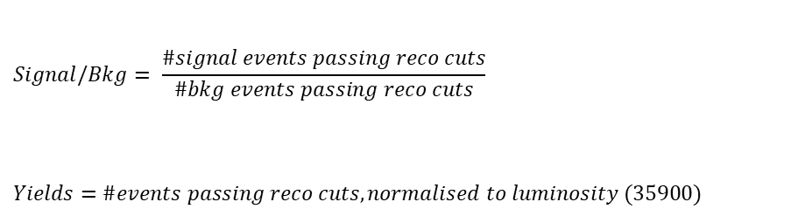
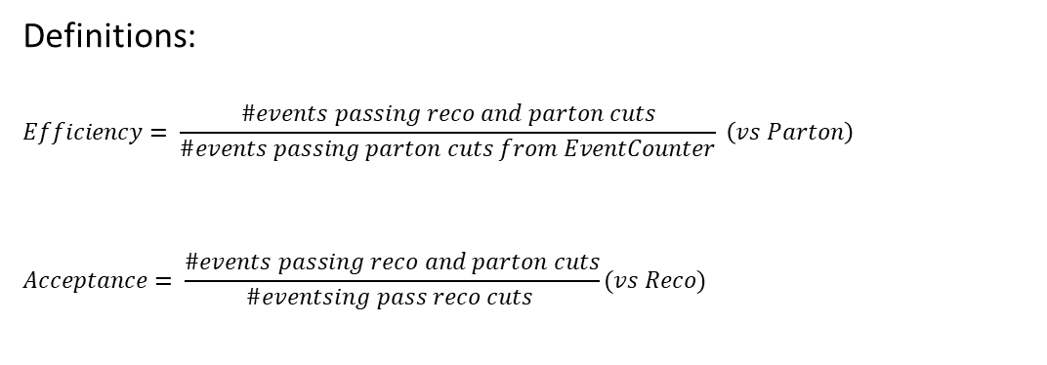
Overview
Efficiencies and Acceptance for mTT and jetPt variables
Selection:
Jet Matching
Parton cuts:
partonPt[0],[1] > 400
|partonEta[0],[1]| < 2.4
mTTbarParton > 1000
Reco cuts:
nJets > 1
nLeptons = 0
mJJ > 1000
jetPt[0],[1] > 400
|jetEta[0],[1]| < 2.4
bTagging cut (mediugm WP deepCSV)
Tagger cut (top Tagger) different for each year (2016: 0.2, 2017:0.0, 2018: 0.1)
JetMassSoftDrop > 120 GeV and < 220 GeV
Definitions:
$$Efficiency= \frac{\#events passing reco and parton cuts}{\#events passing parton cuts from EventCounter} \left(vs Parton\right)$$
$$Acceptance= \frac{\#events passing reco and parton cuts}{\#eventsing pass reco cuts }(vs Reco)$$
$$Signal/Bkg= \frac{\#signal events passing reco cuts}{\#bkg events passing reco cuts}$$
$$Yields=\#events passing reco cuts, normalised to luminosity (35900)$$

Slide 3
Purpose of this presentation
Purpose of this presentation is to find a Working Point for each MC (16, 17, 18) because the training is different for each year
2016: We have already decided 0.2 as a WP
2017: The tested working points are 0.0, 0.05, 0.1, 0.15, 0.18
2018: The tested working points are 0.1, 0.15, 0.18, 0.2
For each of these WP’s we present the efficiency and acceptance and for the WP’s that seem promising (same efficiency for the pT variable) we show the Signal/Bkg and the expected yields
Here we have the efficiencies and acceptances without b tagging cut (slides 5-8) and with b tagging cut (slides 9-12)

Slide 4
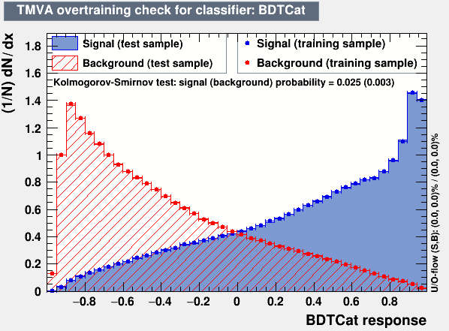
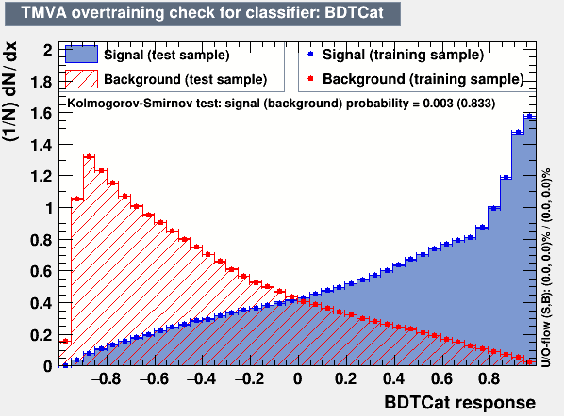
Training Outputs
2017
2018

Slide 5
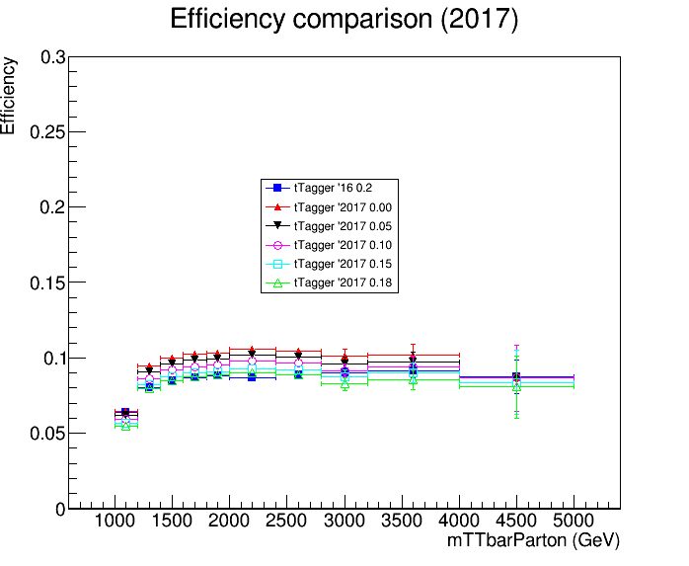
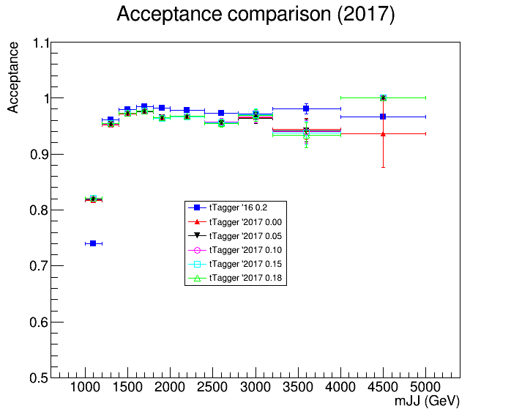
Acceptance and Efficiency 2016 vs 2017 (no btagging requirement)

Slide 6
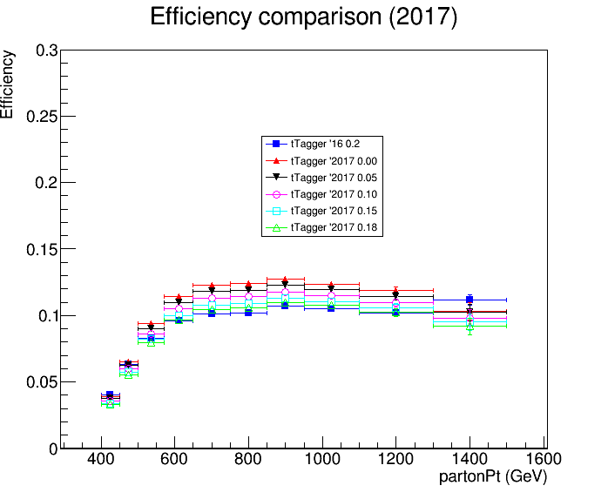
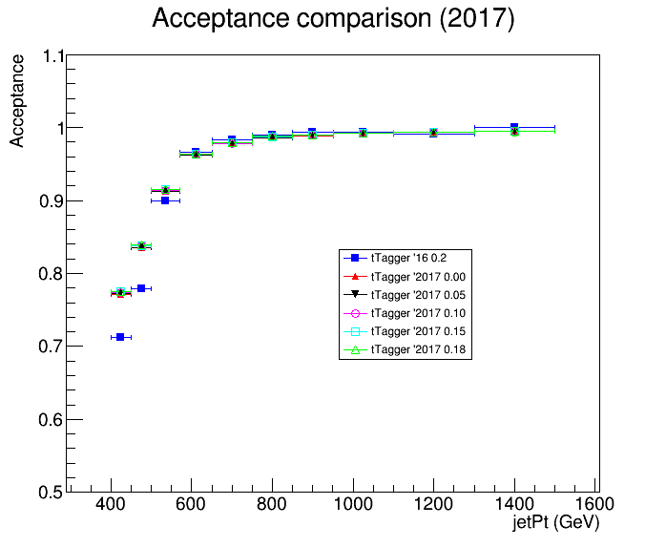
Acceptance and Efficiency 2016 vs 2017 (no btagging requirement)

Slide 7
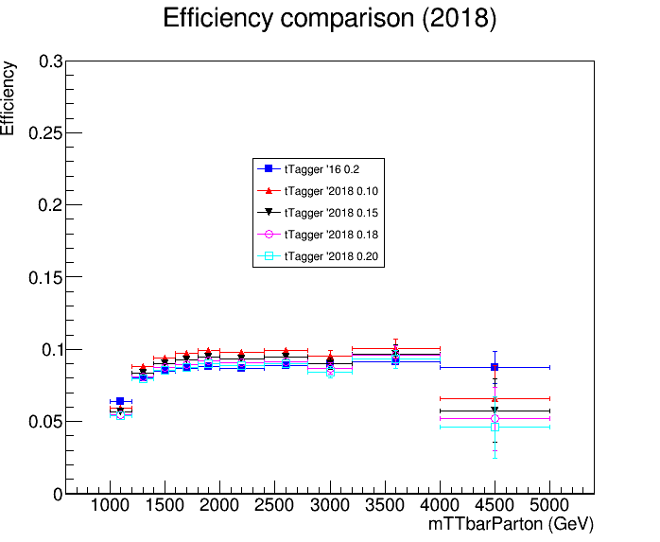
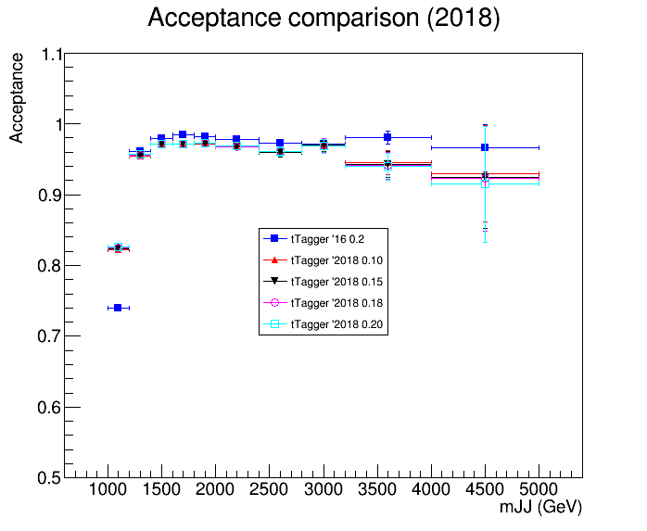
Acceptance and Efficiency 2016 vs 2018 (no btagging requirement)

Slide 8
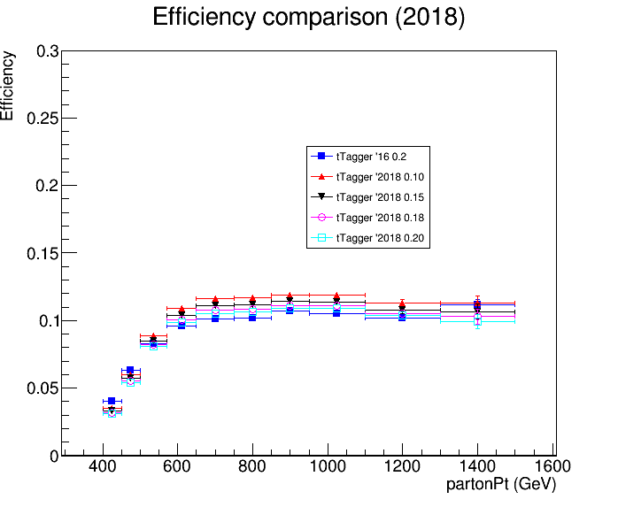
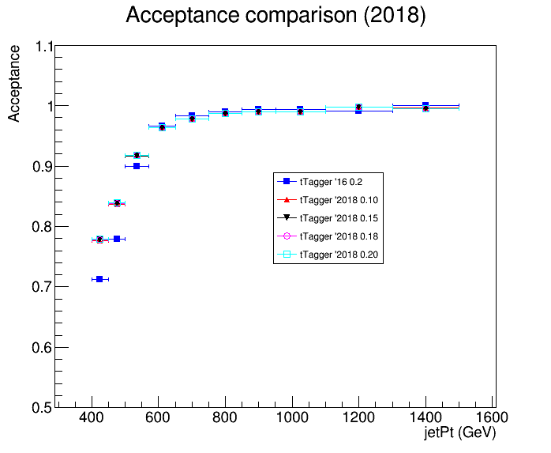
Acceptance and Efficiency 2016 vs 2018 (no btagging requirement)

Slide 9
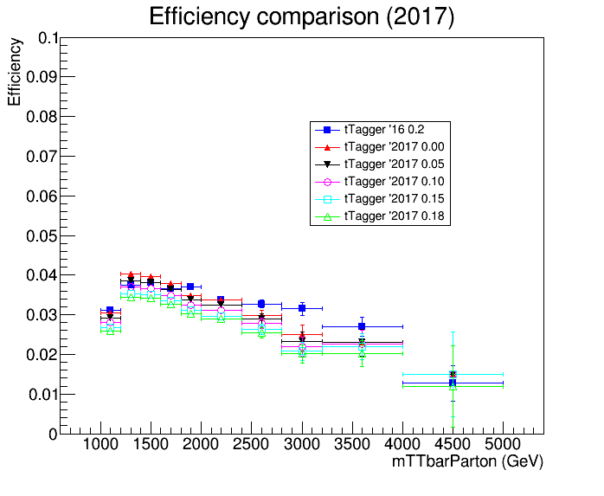
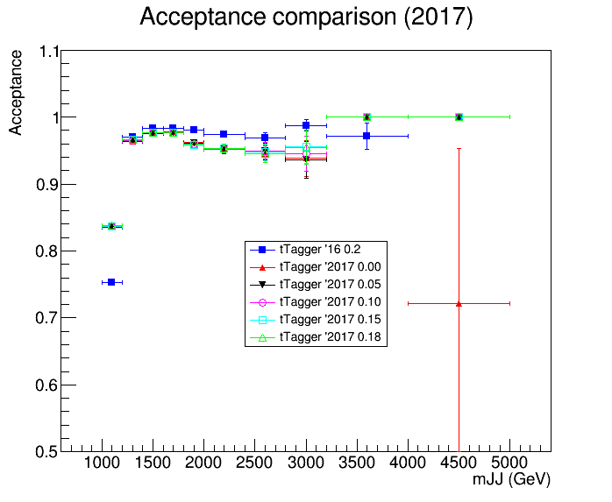
Acceptance and Efficiency 2016 vs 2017 (with btagging)

Slide 10
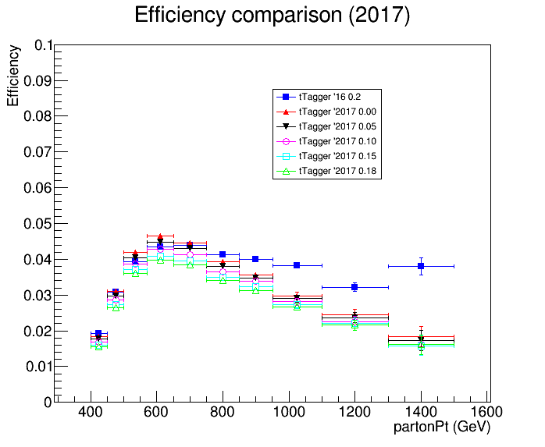
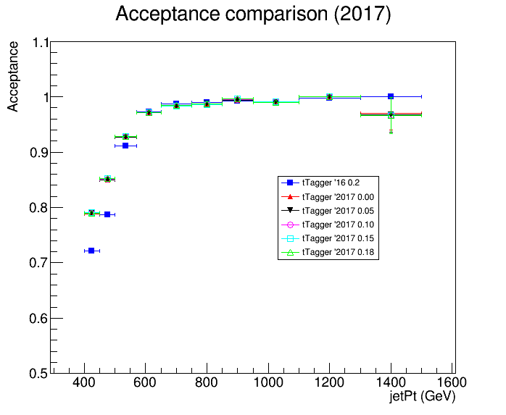
Acceptance and Efficiency 2016 vs 2017 (with btagging)

Slide 11
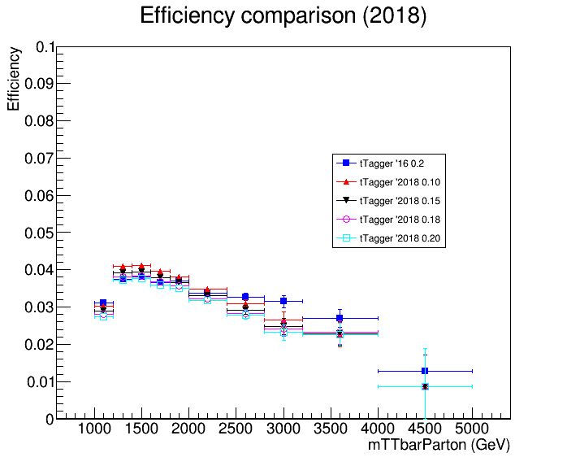
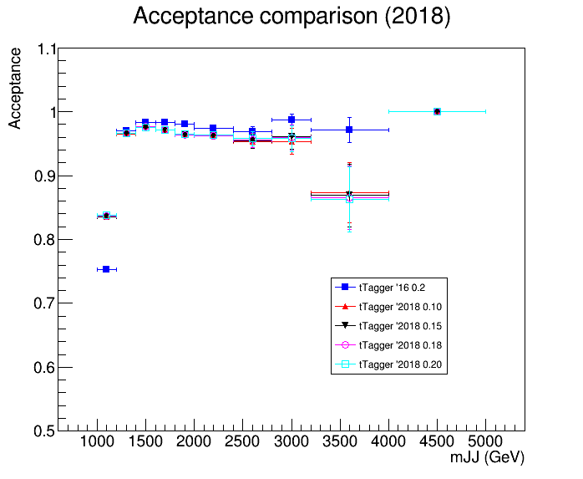
Acceptance and Efficiency 2016 vs 2018 (with btagging)

Slide 12
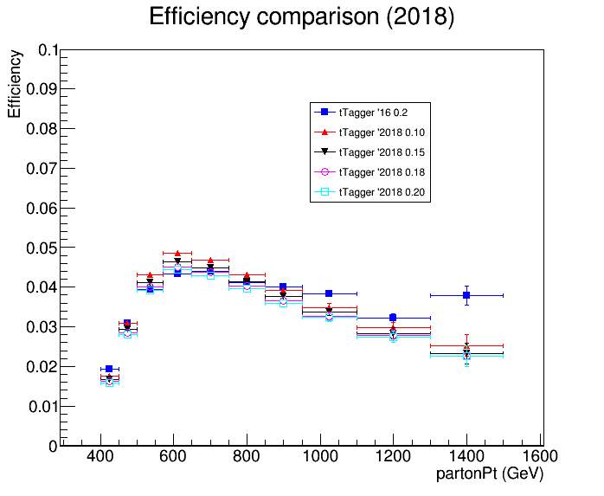
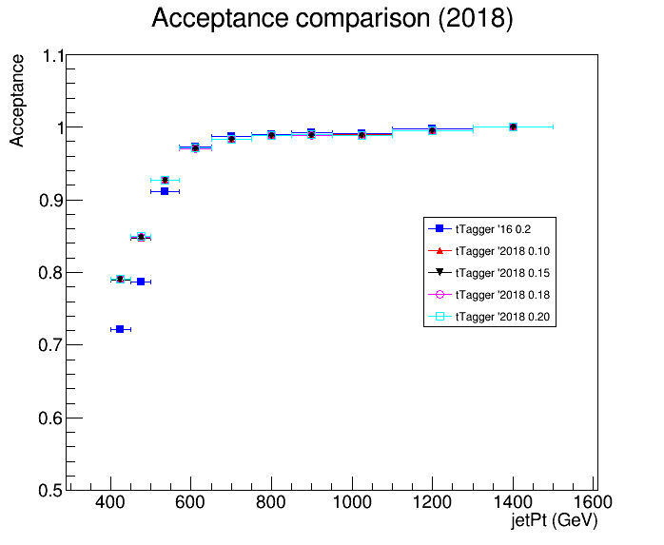
Acceptance and Efficiency 2016 vs 2018 (with btagging)

